Slide 1

SuperClean
Vinhomes Cleaning Service Provider
Team member
Supervisor
Huỳnh Anh Kiệt (Leader)
Trần Đình Anh Minh
Huỳnh Trương Minh Trí
Nguyễn Đỗ Cao Lĩnh
Chử Minh Hải
Mrs. Nguyễn Thị Cẩm Hương
@2023 - Presentation - SWP391

Slide 2

Table Of Content
1
Project Introduction
4
Demonstration
2
System Architecture
5
Outcomes
3
Actors and Features
6
Q&A
@2023 - Presentation - SWP391

Slide 3




1. Project Introduction | Context
congtyvesinh24h.net
giupviectot.vn
Usually have 1 person to work / long time
Not specific to Vinhome households
Have to order through calls and hotlines
@2023 - Presentation - SWP391

Slide 4
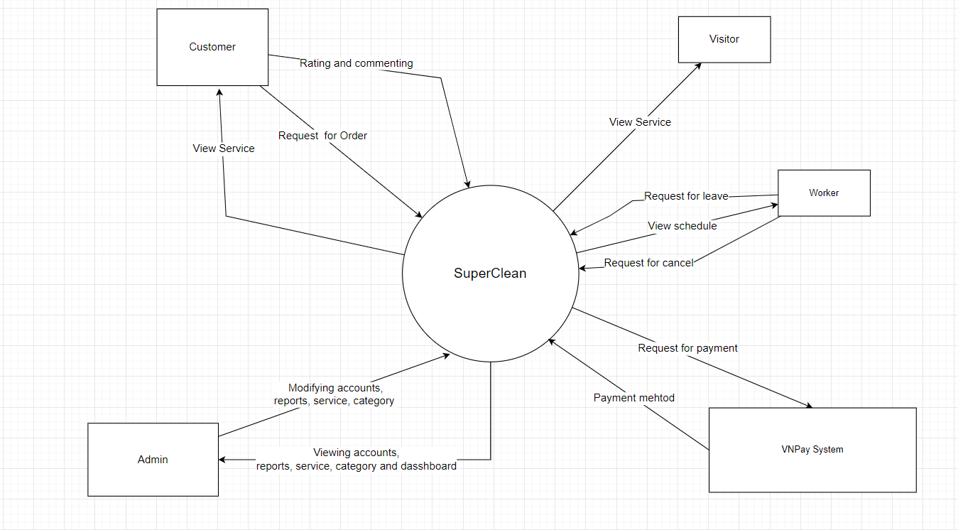
1. Project Introduction | Proposed Solution

Slide 5

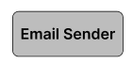
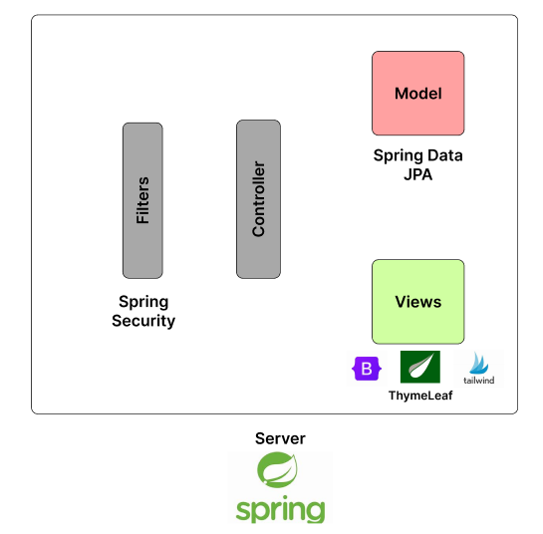




2. System Architecture
APIs, request
JSON
Client
Image

Slide 6



3. Actors and Features | Roles
Customer
Worker
Admin
View Service
Order Service
Feadback
Rating
Update Profile
View Schedue
Confirm Order
Send Leave Report
Cancel the request of Order
Manage Worker
Manage Customer
Manage Service
Manage Category
Manage Order
Manage Leave Report
Manage Cancel Request
View Dashboard
@2023 - Presentation - SWP391

Slide 7
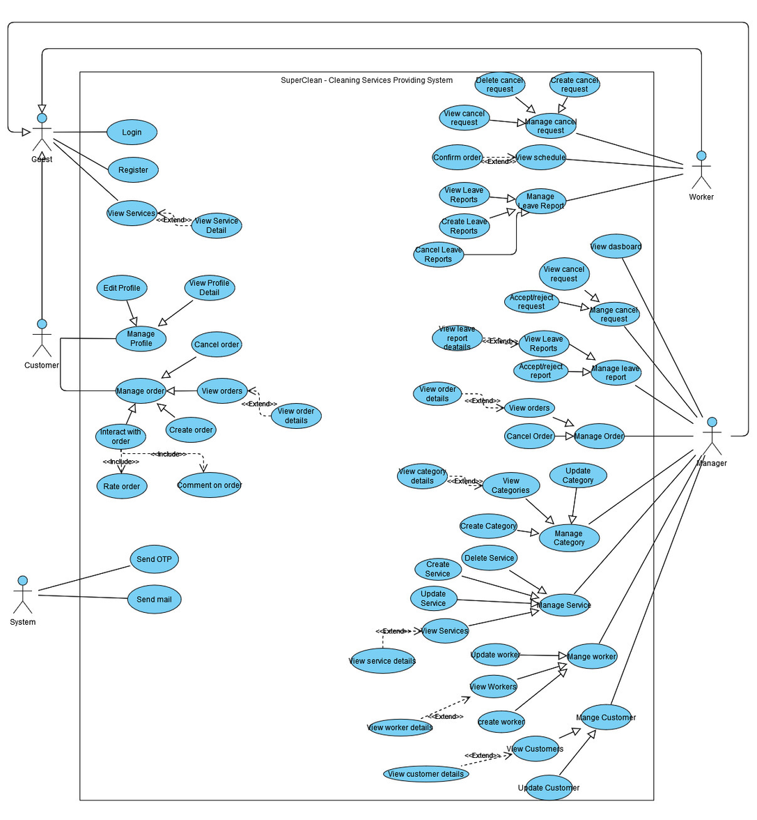
3. Actors and Features | Use Case Diagram
@2023 - Presentation - SWP391

Slide 8






4. Demonstration
Scenario 1: View service and order
Open App
View Service
Register and verify new account
Guest
Order Service
Choose payment method
@2023 - Presentation - SWP391

Slide 9



4. Demonstration
Scenario 2: Rating and leaving feedback after confirming order successfully
Login
Confirm Order
Worker
Login
View success order
Rating and leaving feedback
@2023 - Presentation - SWP391

Slide 10

4. Demonstration
Scenario 3: Make Cancel Request
Login
Leave a report for days-off
Worker
Accept or Reject
Admin
@2023 - Presentation - SWP391

Slide 11

4. Demonstration
Scenario 4: Make Cancel Request
Login
Leave a report for days-off
Worker
Accept or Reject
Admin
@2023 - Presentation - SWP391

Slide 12

4. Demonstration
Scenario 5: View dashboard
Login
View dashboard
Admin
@2023 - Presentation - SWP391

Slide 13



5. Outcomes
Achievement
Create a web application for providing cleaning services with basic functions
Lesson learned
Usage of framework and new technologies
Flexible collaboration and time management
Agile Programming
Limitation
Inefficient use of technology
Not so good software architecture
Lack functionality for worker employment
@2023 - Presentation - SWP391

Slide 14

Q&A

Slide 15
Thank you!

